Slide 1

The NIR corn data set Hongwei PENG
Supervisor: Prof. Tom Fearn
Department of statistical science
University College London
September 3, 2019

Slide 2
Datasets
One of the most easily accessible public data sets
high-dimensional NIR spectroscopic data
80 samples
3 spectra : m5, mp5 and mp6 spectrum
700 spectral points for every spectrum
4 constituents: moisture, oil, protein and starch
corn dataset is available in the website: http://www.eigenvector.com/data/Corn/index.html
Figure: m5 spectrum

Slide 3

Datasets
700 spectral points
80 samples
m5
mp5
PLSR
80 samples
80 samples
moisture
oil
protein
starch
dependent variable Y
80 samples
mp6
independent variable X

Slide 4
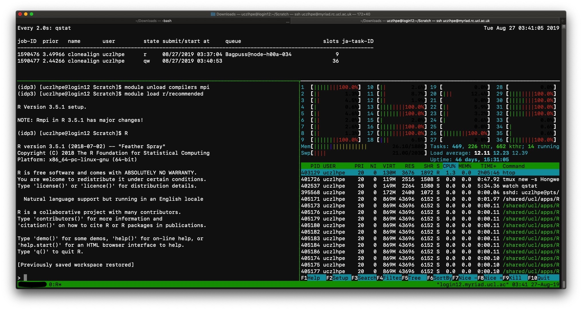
Parallel computing and HPC
HPC: high performance computing system
﻿Number of core | 1 | 9 | 18 | 27 | 36
﻿Running time (s) | 97.42 | 68.84 | 58.56 | 55.77 | 54.97

Slide 5
PLS algorithm
The partial least squares regression (PLS) is a multi-regression technique proposed by Wold et al. (1984).
It is also the most common statistical method in the research of near-infrared spectroscopy (NIR).

Slide 6
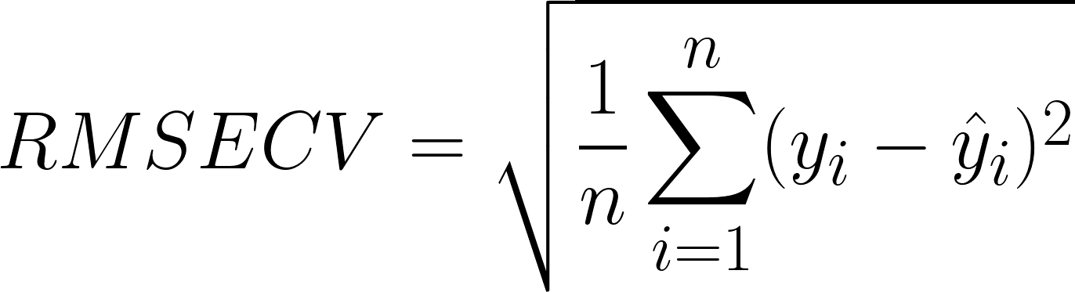
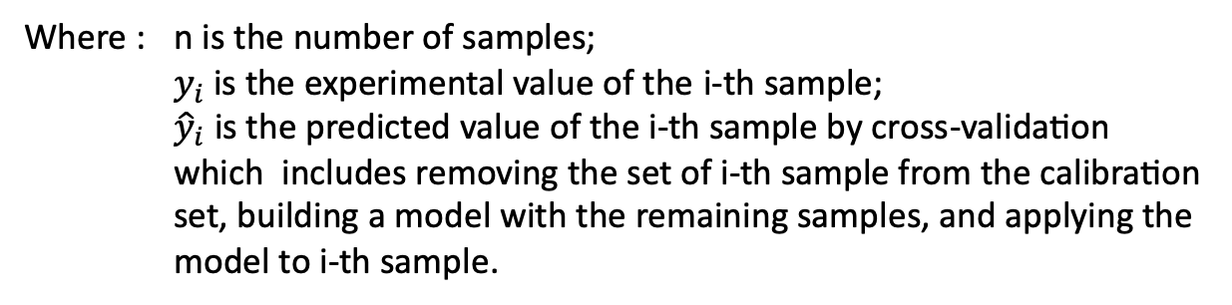
PLS algorithm
the root mean square error of cross-validation (RMSECV):
Where : ﻿ n is the number of samples;
$y_{i}$is the experimental value of the i-th sample;
${\hat{y}}_{i}$ is the predicted value of the i-th sample by cross-validation which includes removing the set of i-th sample from the calibration set, building a model with the remaining samples, and applying the model to i-th sample.

Slide 7
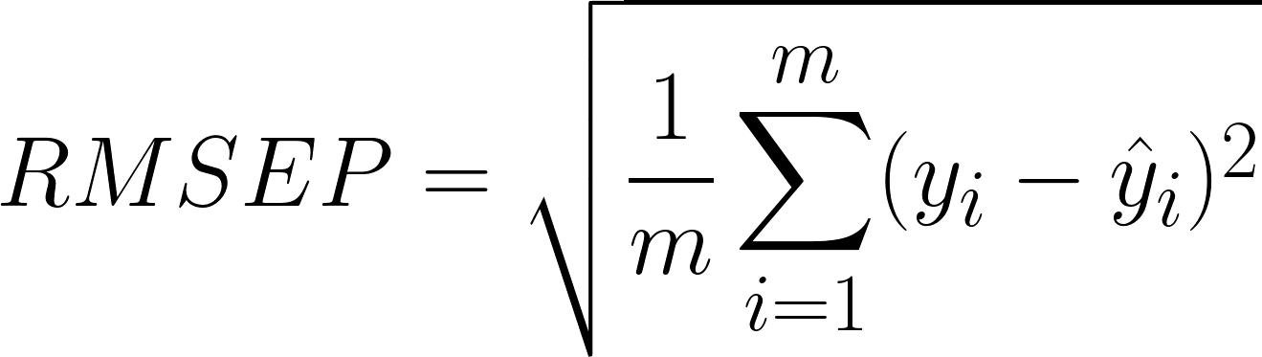

PLS algorithm
﻿the root mean square error of prediction (RMSEP):
Where : ﻿ m is ﻿the number of prediction sets;
$y_{i}$is ﻿the experimental value of the i-th sample in the prediction set;
${\hat{y}}_{i}$ is ﻿the prediction value of model for the i-th sample.

Slide 8
Loop times
Boxplot of RMSECV and RMSEP under different loop times

Slide 9
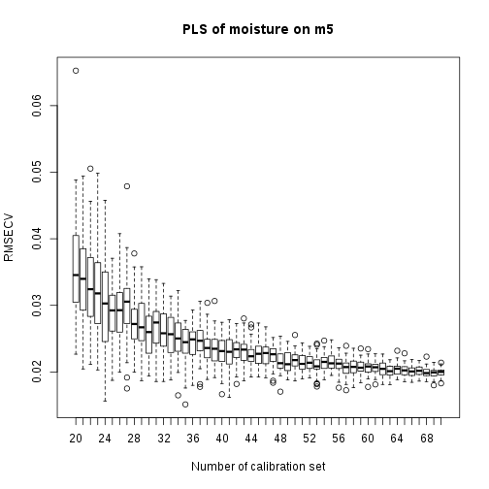
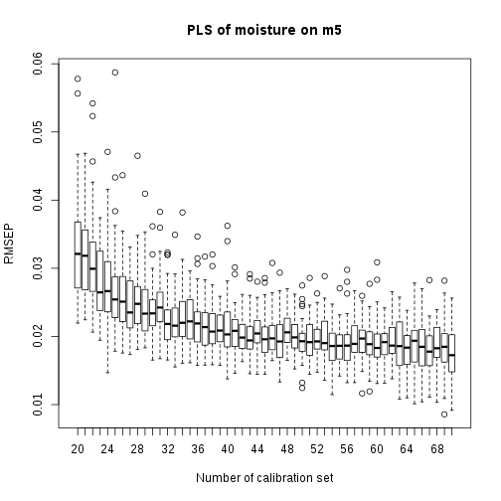
Number of samples
Boxplot of RMSECV and RMSEP under different number of calibration set

Slide 10
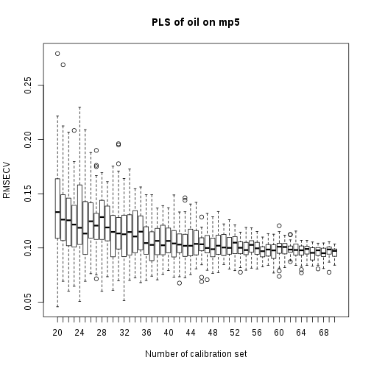
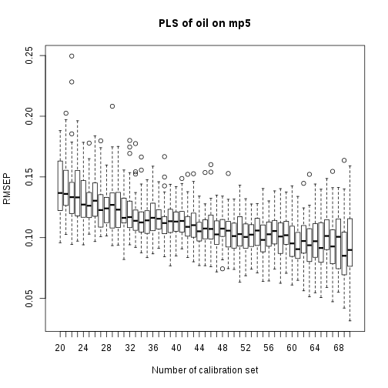
Number of samples
Boxplot of RMSECV and RMSEP under different number of calibration set

Slide 11
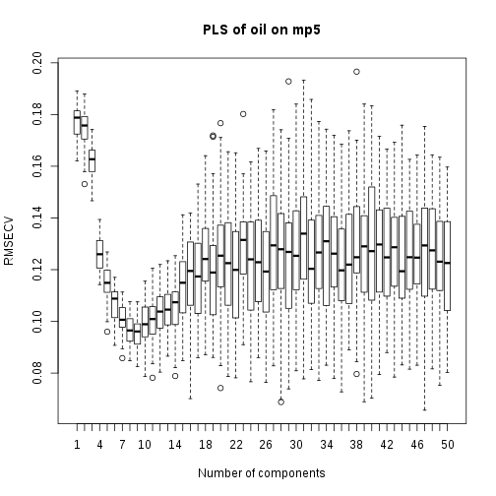
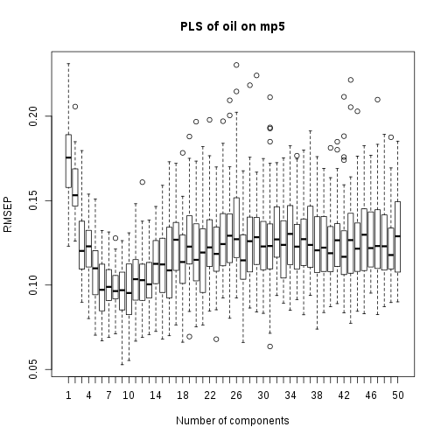
Number of components
As the number of components increases, the regression performer of models should be getting better and better. However, when the number of components is too large and over the threshold, there will be a situation of overfitting. The model's RMSECV and RMSEP will be reduced to a minimum and then rise again, and the variance will gradually increase during the rise process.

Slide 12
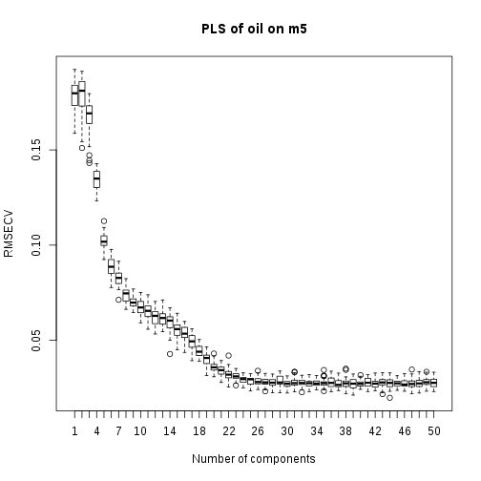
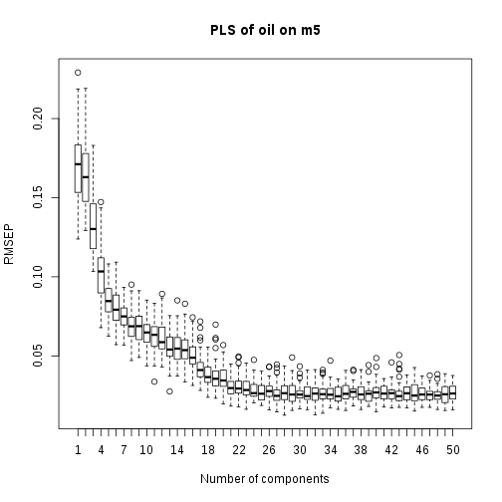
Number of components
But …

Slide 13
Pre-treatment
There were four common pre-treatments:
Nothing to deal with (Su et al., 2006).
Scale the data (Ergon, 2006).
Savitzky-Golay filter processing on the data (Galvão et al., 2007).
Delete the outliers. For example Ji et al. (2015) take out the 75th and 77th corn spectrum from dataset as outliers.

Slide 14
Pre-treatment
Raw data
Standardization
Savitzky-Golay filter

Slide 15
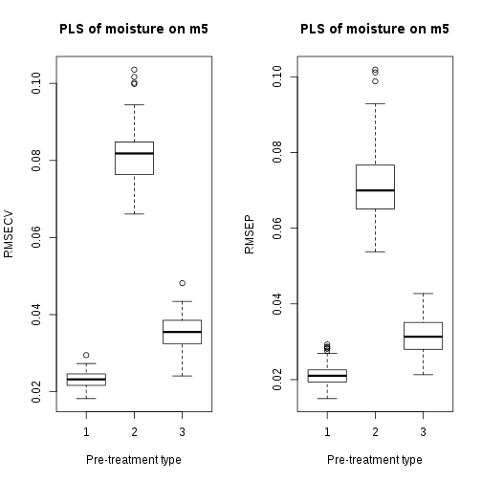
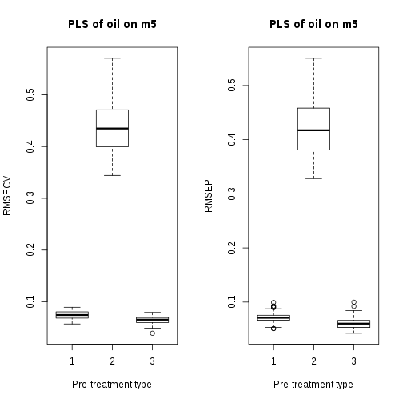
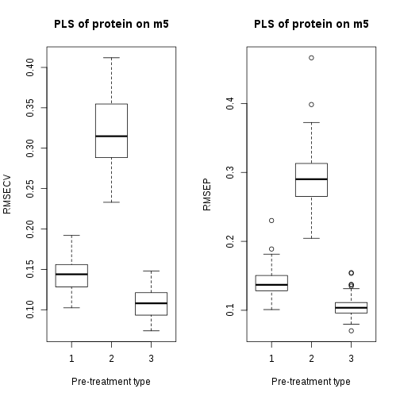
Pre-treatment
The boxplot of RMSECV and RMSEP from 100 loop times PLSR under different pre-treatment. “1” stand for none pre-treatment; “2” stand for scale X; “3” stand for Savitzky-Golay filler with 1 differentiation order, 2 polynomial order, 21 window size. And 40 samples as calibration set take leave-one-out as cross validation.

Slide 16
Pre-treatment
Standardization has the worst performance.
Because Standardization takes meaningless data into PLSR.
Savitzky-Golay filter has a better performance in most situations. ﻿
Because Savitzky-Golay filter smoothes data, and fixes data’s displacement.
SavitzkyGolay filter makes model more robust.

Slide 17
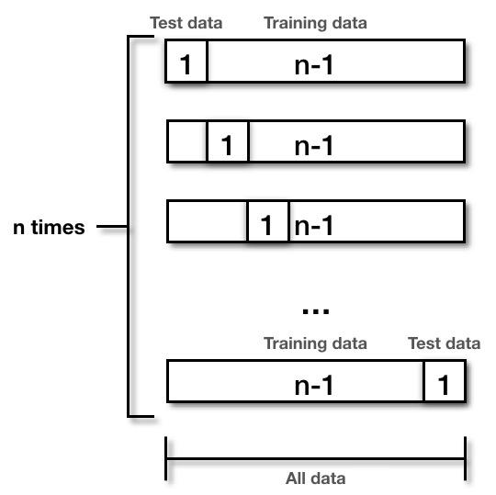
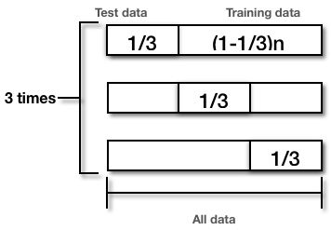
Cross-validation
Leave-one-out cross validation:
3-fold cross validation:

Slide 18
Cross-validation
﻿RMSEP curves under LOO and K-fold

Slide 19
Cross-validation

Slide 20
Cross-validation

Slide 21
Cross-validation

Slide 22
Cross-validation
When the amount of sample data is small, the difference between LOO and K-fold is not obvious.
However, it should be noted that when the amount of data is too large, the LOO can easily cause the model over-fitting, which is not what we hope.

Slide 23
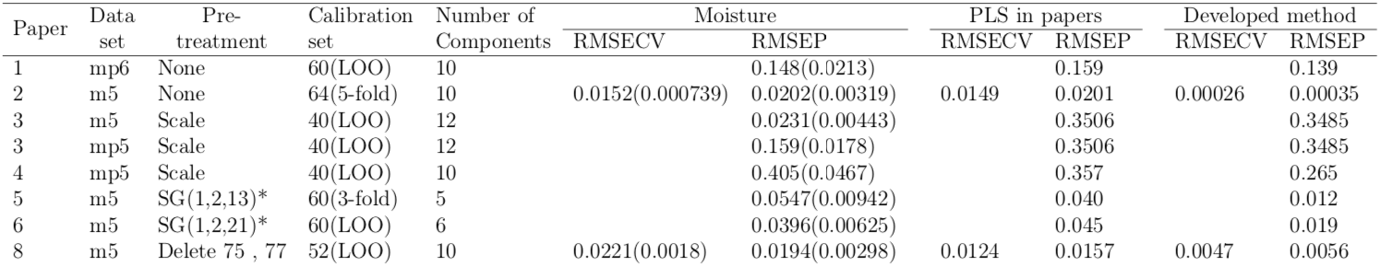
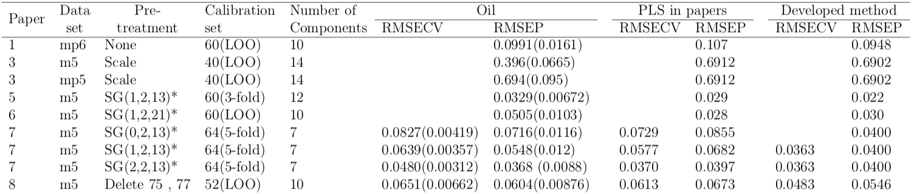
Compare with papers

Slide 24
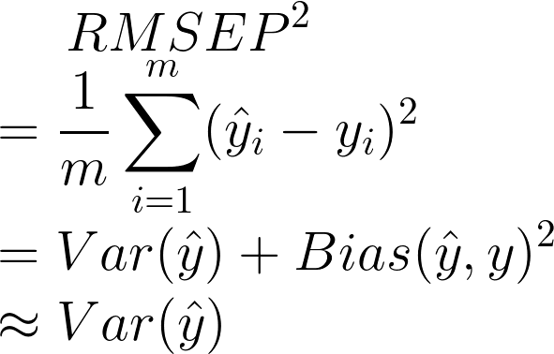
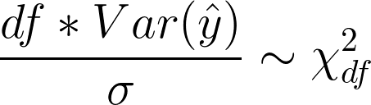
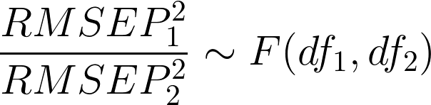
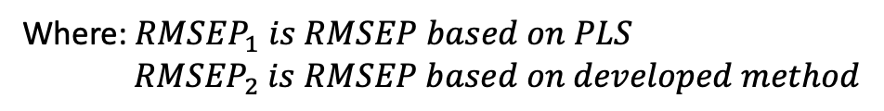
Developed method’s F-test
Because:
Hence:
Where:${ RMSEP}_{1} is RMSEP based on PLS$
${RMSEP}_{2} is RMSEP based on developed method$

Slide 25
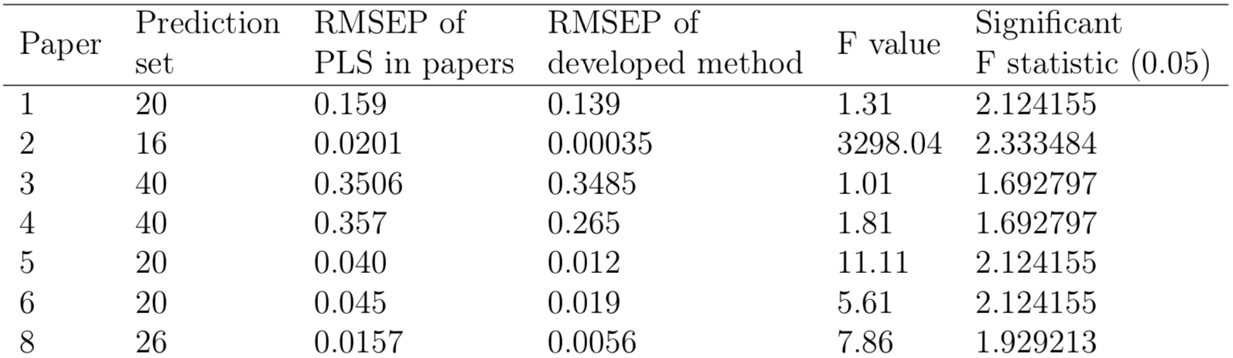
Developed method’s F-test
﻿F-test on regression of moisture.

Slide 26
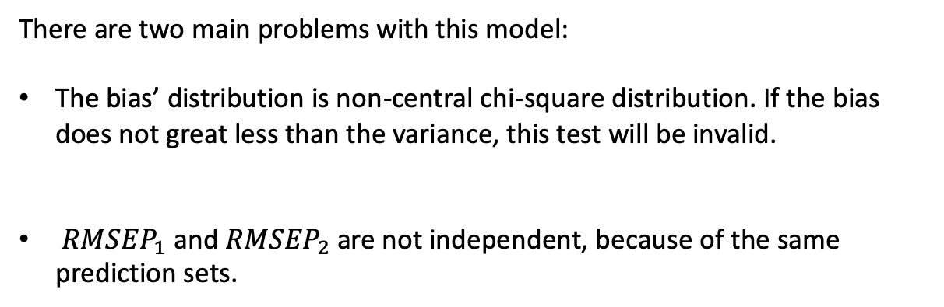
Developed method’s F-test
There are two main problems with this model:
﻿The bias’ distribution is non-central chi-square distribution. If the bias does not great less than the variance, this test will be invalid.
﻿ ${RMSEP}_{1}$ and ${RMSEP}_{2}$are not independent, because of the same prediction sets.

